Slide 1
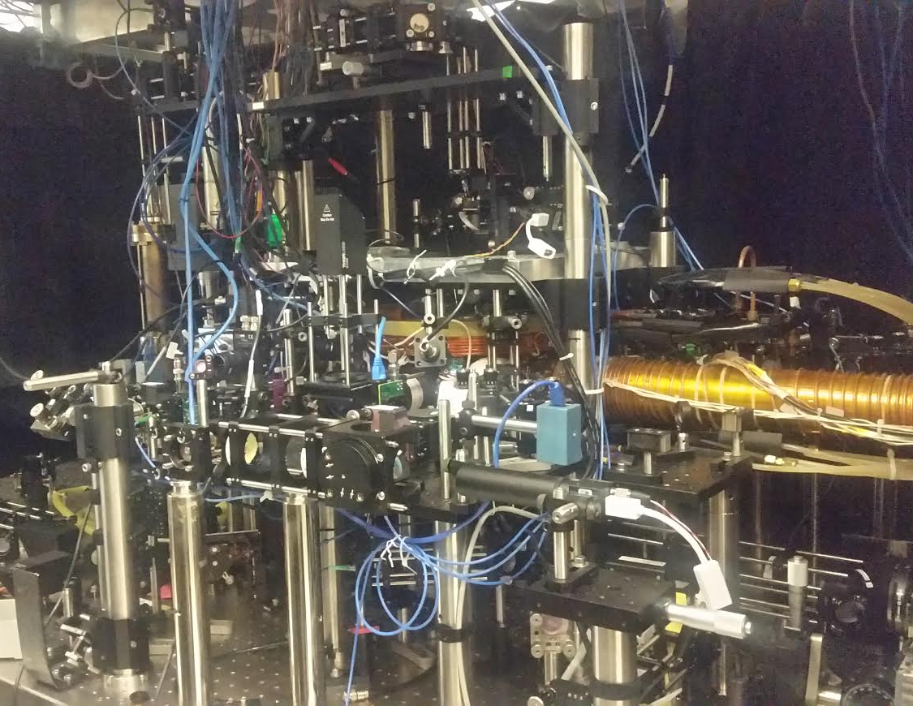
Attic
Balcony
Chamber
Zeeman slower
Main floor
Basement

